Slide 1
Tools, REST, Swagger
Notes:
(2min)
Speaker introduction
Relevant experience
Credentials
Takeaway of this course

Slide 2
What is REST?
Explore typical problem & solutions
Popular REST approach
Deep-dive REST and Pitfalls of REST
What is Swagger
Exercise
References
Notes:
(1min)

Slide 3
What is REST?

Slide 4
What is REST?
Representational state transfer
An architectural style for sharing data between applications
Structured architectural properties
Implemented via HTTP
Notes:
(3min)
standards—that which we know is right or wrong—and styles provide a set of principles to follow
REST, or REpresentational State Transfer, is an architectural style for providing standards between computer systems on the web,
It is a standard, making it easier for systems to communicate with each other.
For those system or APIs which is REST-compliant, we can call it RESTful systems. The have their own characteristic, such as how they are stateless and separate the concerns of client and server.
A REST API defines a set of functions to receive requests and send out responses via HTTP protocol
We have 3 terms here
REST - it is a architectural style or design
RESTFUL – it means the system / API which is REST-compliant
REST API – a set of functions for us to consume.
The following slides will elaborate on these four concepts

Slide 5
What is REST? – Representational state transfer
Representations:
How resource(e.g get manipulated)
Part of the resource state transferred between client and server
JSON or XML
Example:
Resource: Doctor
Service: Doctor Profile
Representation:
Name, Id
JSON
Representational state transfer
Notes:
(4min)
Representational State Transfer refers to transferring "representations". You are using a "representation" of a resource to transfer resource state between the client and the server

Slide 6
What is REST? – Architectural style and properties
6 constraints in REST architectural style:
Uniform Interface
Stateless
Cacheable
Client-Server
Layered System
Code on Demand (optional)
An architectural style for sharing data between applications
Structured architectural properties
Notes:
(3min) The REST’s architectural style contains 6 contains
The six constraints are: (click the constraint to read more)
Uniform Interface - The uniform interface constraint defines the interface between clients and servers. It simplifies and decouples the architecture, which enables each part to evolve independently.
Stateless - statelessness is key. Essentially, what this means is that the necessary state to handle the request is contained within the request itself, whether as part of the URI, query-string parameters, body, or headers. The URI uniquely identifies the resource and the body contains the state (or state change) of that resource. Then after the server does it's processing, the appropriate state, or the piece(s) of state that matter, are communicated back to the client via headers, status and response body.
Cacheable - clients can cache responses. Responses must therefore, implicitly or explicitly, define themselves as cacheable, or not, to prevent clients reusing stale or inappropriate data in response to further requests. Well-managed caching partially or completely eliminates some client–server interactions, further improving scalability and performance.
Cache-Control header to our response
Client-Server - The uniform interface separates clients from servers. This separation of concerns means that, for example, clients are not concerned with data storage, which remains internal to each server, so that the portability of client code is improved. Servers are not concerned with the user interface or user state, so that servers can be simpler and more scalable. Servers and clients may also be replaced and developed independently, as long as the interface is not altered.
Layered System - A client cannot ordinarily tell whether it is connected directly to the end server, or to an intermediary along the way. Intermediary servers may improve system scalability by enabling load-balancing and by providing shared caches. Layers may also enforce security policies.
Code on Demand (optional) - Servers are able to temporarily extend or customize the functionality of a client by transferring logic to it that it can execute. Examples of this may include compiled components such as Java applets and client-side scripts such as JavaScript.
For a API which is REST compliant, the architecture must contain the these 6 characteristic

Slide 7
What is REST? – Architectural style and properties
Uniform Interface
Define the interface between client and server
Simplifies and decouple architecture
Restful design:
HTTP verbs (e.g Get, Put, Post, Delete)
URIs (resource name)
HTTP response (status, body)
Stateless
Server contains no client state
Self-descriptive message
Notes:
(3min)
Uniform Interface - The uniform interface constraint defines the interface between clients and servers. It simplifies and decouples the architecture, which enables each part to evolve independently.
Identification of resources
Each resource in a RESTful design must be uniquely identifiable via an URI (Uniform Resource Identifier)
Manipulation of resources through these representations
resources are manipulated through representations.
Self-descriptive messages
each message (i.e. request/response) must include enough information for the receiver to understand it in isolation.
Create a new customer POST /customers
Delete an existing customer DELETE /customers/{id}
Get a specific customer GET /customers/{id}
Search for customers GET /customers
Update an existing customer PUT /customers/{id}
Hypermedia as the engine of application state (A.K.A. HATEOAS)
Clients make state transitions only through actions that are dynamically identified within hypermedia by the server (e.g., by hyperlinks within hypertext)
Stateless - statelessness is key. Essentially, what this means is that the necessary state to handle the request is contained within the request itself, whether as part of the URI, query-string parameters, body, or headers. The URI uniquely identifies the resource and the body contains the state (or state change) of that resource. Then after the server does it's processing, the appropriate state, or the piece(s) of state that matter, are communicated back to the client via headers, status and response body.

Slide 8
What is REST? – Architectural style and properties
Client-Server
Assume a disconnected system
Uniform interface to connect client and server
Cacheable
Server responses are cacheable
Implicitly (Client defined)
Explicitly (Server defined: e.g max-age)
Negotiated
Notes:
(3min)
Cacheable - clients can cache responses. Responses must therefore, implicitly or explicitly, define themselves as cacheable, or not, to prevent clients reusing stale or inappropriate data in response to further requests. Well-managed caching partially or completely eliminates some client–server interactions, further improving scalability and performance.
Cache-Control header to our response
Client-Server - The uniform interface separates clients from servers. This separation of concerns means that, for example, clients are not concerned with data storage, which remains internal to each server, so that the portability of client code is improved. Servers are not concerned with the user interface or user state, so that servers can be simpler and more scalable. Servers and clients may also be replaced and developed independently, as long as the interface is not altered.

Slide 9
What is REST? – Architectural style and properties
Layered System
Client can’t assume direct connection to server
Improves scalability
Code on Demand (Optional)
Transfer logic to client
Client functionality cab be extended by downloading and executing code in the form of applets or scripts
Notes:
3 mins
Code-on-Demand (COD)
Layered System - A client cannot ordinarily tell whether it is connected directly to the end server, or to an intermediary along the way. Intermediary servers may improve system scalability by enabling load-balancing and by providing shared caches. Layers may also enforce security policies.
Code on Demand (optional) - Servers are able to temporarily extend or customize the functionality of a client by transferring logic to it that it can execute. Examples of this may include compiled components such as Java applets and client-side scripts such as JavaScript.
is the only optional constraint in REST. It allows clients to improve its flexibility because in fact it is the server who decides how certain things will be done. For instance, with Code-On-Demand, a client can download a javascript, java applet or even a flash application in order to encrypt communication so servers are not aware of any encryption routines / keys used in this process.
However, using COD reduces visibility, which is why this constraint is optional. Also, not every API needs this kind of flexibility

Slide 10
Explore typical problem & solutions

Slide 11

Explore typical problem & solutions
Explore this problem: You’re a web developer building a healthcare product. You need to retrieve patient data from the server. What are some of the typical ways to retrieve data in this scenario?
Notes:
(4min)
REST
SOAP
RPC
SFTP
DB-link

Slide 12
Typical solutions offer some benefits… but they come with drawbacks
Custom protocol implementation
Direct database access
SOAP
REST APIs & similar implementations
Benefits
Full control over implementation
Security can be integrated into existing systems
SQL is easy & ubiquitously known
Flexibility of a query engine
Very descriptive API
Utilizes secured authentication
More detailed discussion to follow
Drawbacks
Considerable time spend
Potential for security breaches
Tight coupling b/w client & database
Potential for security breaches
Tight coupling b/w client & database
Lack of supported data formats
Notes:
(4min)
SOAP means Simple Object Access Protocol.
SOAP is XML based and has a more structure. SOAP is self describing though a document called a WSDL.
It is an XML-based messaging protocol for exchanging information among computers. SOAP is an application of the XML specification. Because use XML, some data formats cannot be supported well. Such as arrays
REST is not really a protocol but rather a set of suggestions that is usually used over HTTP(s) - the same protocol used for websites. REST can use XML or JSON to structure input and output data.
===
Contrast REST with other standards, such as SOAP, RPC
There's a letter analogy that I liked a lot about SOAP vs REST, with SOAP you are using an envelope, with REST, it's a postcard, so Obviously SOAP has some extra overhead: more bandwidth(more paper), extra work for both parties(wrapping and unwrapping). But that doesn't mean REST is not as secure as SOAP since you can use HTTPS (think of it as replacing the mailman with someone who only speaks foreign languages)
SOAP vs REST: Primary Differences
REST operates through a solitary, consistent interface to access named resources. It’s most commonly used when you’re exposing a public API over the Internet. SOAP, on the other hand, exposes components of application logic as services rather than data. Additionally, it operates through different interfaces. To put it simply, REST accesses data while SOAP performs operations through a more standardized set of messaging patterns. Still, in most cases, either REST or SOAP could be used to achieve the same outcome (and both are infinitely scalable), with some differences in how you’d configure it.
SOAP was originally created by Microsoft, and it’s been around a lot longer than REST. This gives it the advantage of being an established, legacy protocol. But REST has been around for a good time now as well. Plus, it entered the scene as a way to access web services in a much simpler way than possible with SOAP by using HTTP.
Benefits of REST Over SOAP
In addition to using HTTP for simplicity, REST offers a number of other benefits over SOAP:
REST allows a greater variety of data formats, whereas SOAP only allows XML.
Coupled with JSON (which typically works better with data and offers faster parsing), REST is generally considered easier to work with.
Thanks to JSON, REST offers better support for browser clients.
REST provides superior performance, particularly through caching for information that’s not altered and not dynamic.
It is the protocol used most often for major services such as Yahoo, Ebay, Amazon, and even Google.
REST is generally faster and uses less bandwidth. It’s also easier to integrate with existing websites with no need to refactor site infrastructure. This enables developers to work faster rather than spend time rewriting a site from scratch. Instead, they can simply add additional functionality.
Still, SOAP remains the preferred protocol for certain use cases. The general consensus among experts these days is that REST is the typically preferred protocol unless there’s a compelling reason to use SOAP (and there are some cases in which SOAP is preferred).
Benefits of SOAP Over REST
Because you can achieve most outcomes using either protocol, it’s sometimes a matter of personal preference. However, there are some use cases that SOAP tends to be better-suited for. For instance, if you need more robust security, SOAP’s support for WS-Security can come in handy. It offers some additional assurances for data privacy and integrity. It also provides support for identity verification through intermediaries rather than just point-to-point, as provided by SSL (which is supported by both SOAP and REST).
Another advantage of SOAP is that it offers built-in retry logic to compensate for failed communications. REST, on the other hand, doesn’t have a built-in messaging system. If a communication fails, the client has to deal with it by retrying. There’s also no standard set of rules for REST. This means that both parties (the service and the consumer) need to understand both content and context.
Other benefits of SOAP include:
SOAP’s standard HTTP protocol makes it easier for it to operate across firewalls and proxies without modifications to the SOAP protocol itself. But, because it uses the complex XML format, it tends to be slower compared to middleware such as ICE and COBRA.
Additionally, while it’s rarely needed, some use cases require greater transactional reliability than what can be achieved with HTTP (which limits REST in this capacity). If you need ACID-compliant transactions, SOAP is the way to go.
In some cases, designing SOAP services can actually be less complex compared to REST. For web services that support complex operations, requiring content and context to be maintained, designing a SOAP service requires less coding in the application layer for transactions, security, trust, and other elements.
SOAP is highly extensible through other protocols and technologies. In addition to WS-Security, SOAP supports WS-Addressing, WS-Coordination, WS-ReliableMessaging, and a host of other web services standards, a full list of which you can find on W3C.
At the end of the day, the best protocol is the one that makes the most sense for the organization, the types of clients that you need to support, and what you need in terms of flexibility. Most new APIs are built using REST and JSON, simply because it typically consumes less bandwidth and is easier to understand both for developers implementing initial APIs as well as other developers who may write other services against it. Because it’s more easily consumed by most of today’s web browsers, REST+JSON has become the defacto technology for the majority of public APIs.

Slide 13
Let's evaluate REST more closely in this scenario
Supports any hypertext format
Protocol independent – abstraction, authentication, communication and CRUD operations
APIs are independent of client
Requires fewer resources in transport as well as description
Caching utilizes less network resources
Notes:
(3min)
Supports any hypertext format because REST is based on HTTP protocol (leverage Http protocol)
The key abstraction of information in REST is a resource
Any information that can be named can be a resource: a document or image, a temporal service (e.g. "today's weather in Los Angeles"), a collection of other resources, a non-virtual object (e.g. a person), and so on

Slide 14
Popular REST approach

Slide 15
API path naming convention
Verbs are bad
Nouns are good
Plurals are better
For complex variations, put them after “?”
e.g. /dogs?color=brown&state=running&location=park
Notes:
(2min)
Examples are described in cookbook

Slide 16
REST API
Using HTTP Methods for RESTful Services
POST - used to create a new entity, but it can also be used to update an entity
GET - used to read (or retrieve) a representation of a resource
PUT - update an existing entry
DELETE - delete an entry; however, the resource does not have to be removed immediately. It could be an asynchronous or long-running request
Notes:
(3min)
For the same URI, REST API can represents different resource actions

Slide 17
HTTP status codes
1XX - informational
2XX - success
3XX - redirection
4XX - client error
5XX - server error
Notes:
1 min
In REST APIs, it can inform the client of the request overarching result by using the HTTP response message

Slide 18
Samples
The first one is for a collection
e.g. /dogs
The second is for an element
e.g. /dogs/1234
Resource | POST create | GET read | PUT update | DELETE delete
/dogs | create a new dog | list dogs | bulk update dogs | delete all dogs
/dogs/foo | error | show Foo | if exists, update Foo; if not, error | delete Foo
Notes:
(3min)

Slide 19
Explore typical problem & solutions
Let's add a dimension to our problem: We've chosen to utilize REST APIs to retrieve the data for a patient and the doctors s/he may've visited. What would our REST API solution look like?
Notes:
(3min)

Slide 20
Explore typical problem & solutions
We would need a data model w/ 3 entities - Patients, Visits, and Doctors… …and we would write conforming code as our solution
Patients
var express = require("express");
var app = express();
var router = express.Router();
router.route("/patients/:id").get(function(req, res) {
var patient = db.getPatient(req.body.id);
res.json(patient);
});
router.route("/doctors/:id").get(function(req, res) {
var doctor = db.getDoctor(req.body.id);
res.json(doctor);
});
router.route(“/visits/:patientId”).get(function(req, res) {
var visits = db.getVisits(req.body.patientId);
res.json(visits);
});
Simplified REST API
ID
Name
Visits
…but where might our solution struggle?
Patient ID
Doctor ID
Completed
Doctors
ID
Name
Notes:
(3min)

Slide 21
Deep-dive REST and Pitfalls of REST

Slide 22
Pitfalls of REST
REST comes with pitfalls to be aware of…
REST APIs are synchronous & hence resource intensive
REST offers fewer verbs to operate on (e.g. no upsert/merge functionality)
Loses relationships between entities
Often misused losing scalability
Notes:
(3min)
https://www.infoq.com/news/2013/05/rest-drawbacks
Implementation could affect scalability

Slide 23
Pitfalls of REST
Even the popular REST implementations have pitfalls to be aware of…
router.route("/patientsWithDoctors/:patientId").get(function(req, res) {
var result = {
patient: {},
doctors: []
};
result[‘patient’] = db.getPatient(req.body.patientId);
var visits = db.getVisits(req.body.patientId);
visits.forEach(function(visit) {
result.doctors.push(db.getDoctor(visit.doctor_id));
});
res.json(result);
});
Does not conform to standards
Increases implementation complexity
Endpoints tailored to specific use case – restricting reuse
Any new feature requires editing an endpoint, resulting into potential breaking changes
Popular REST API
Discuss the downside of this approach
Notes:
(3min)

Slide 24
What is SWAGGER?

Slide 25
SWAGGER
Swagger is a framework for describing your API using a common language that everyone can understand. Think of it as a blueprint for a house. You can use whatever building materials you like, but you can't step outside the parameters of the blueprint.
It's comprehensible for developers and non-developers.
It's human readable and machine readable.
It's easily adjustable.
Notes:
(3min)
We could use swagger to generate microservices with different REST endpoint

Slide 26
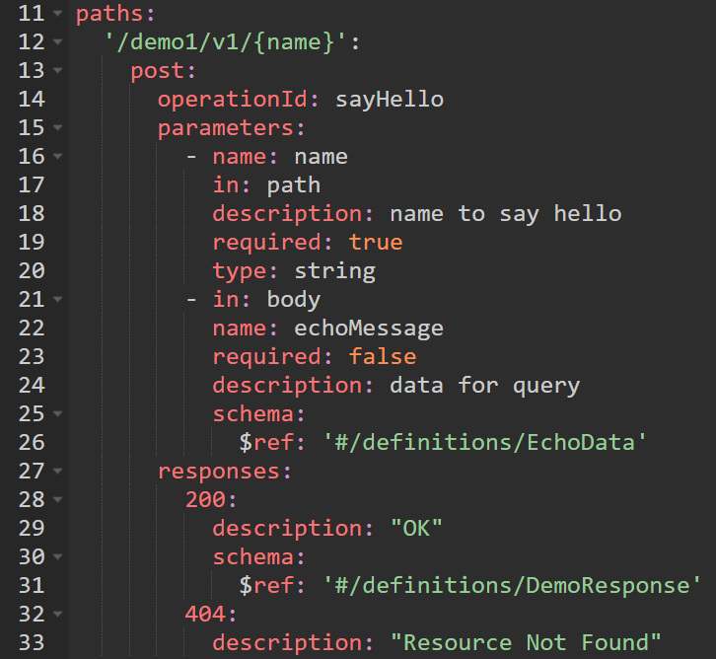
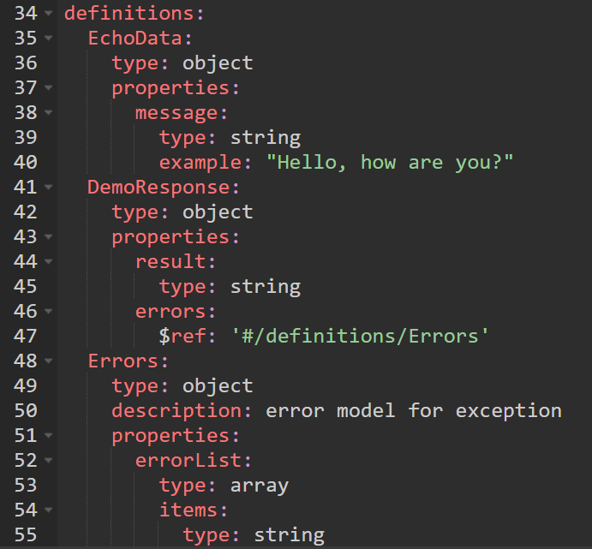
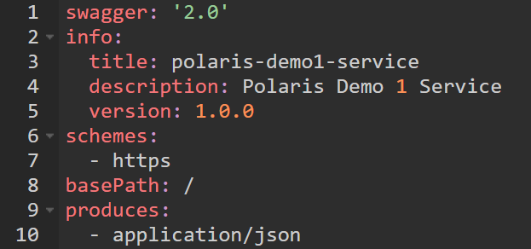
Sample SWAGGER File
Header
API Paths
Definitions
Notes:
(3min)
Swagger file is the specification file to describe your API ends.
It contains 3 parts: Header , API Paths and Definitions (data structure)

Slide 27
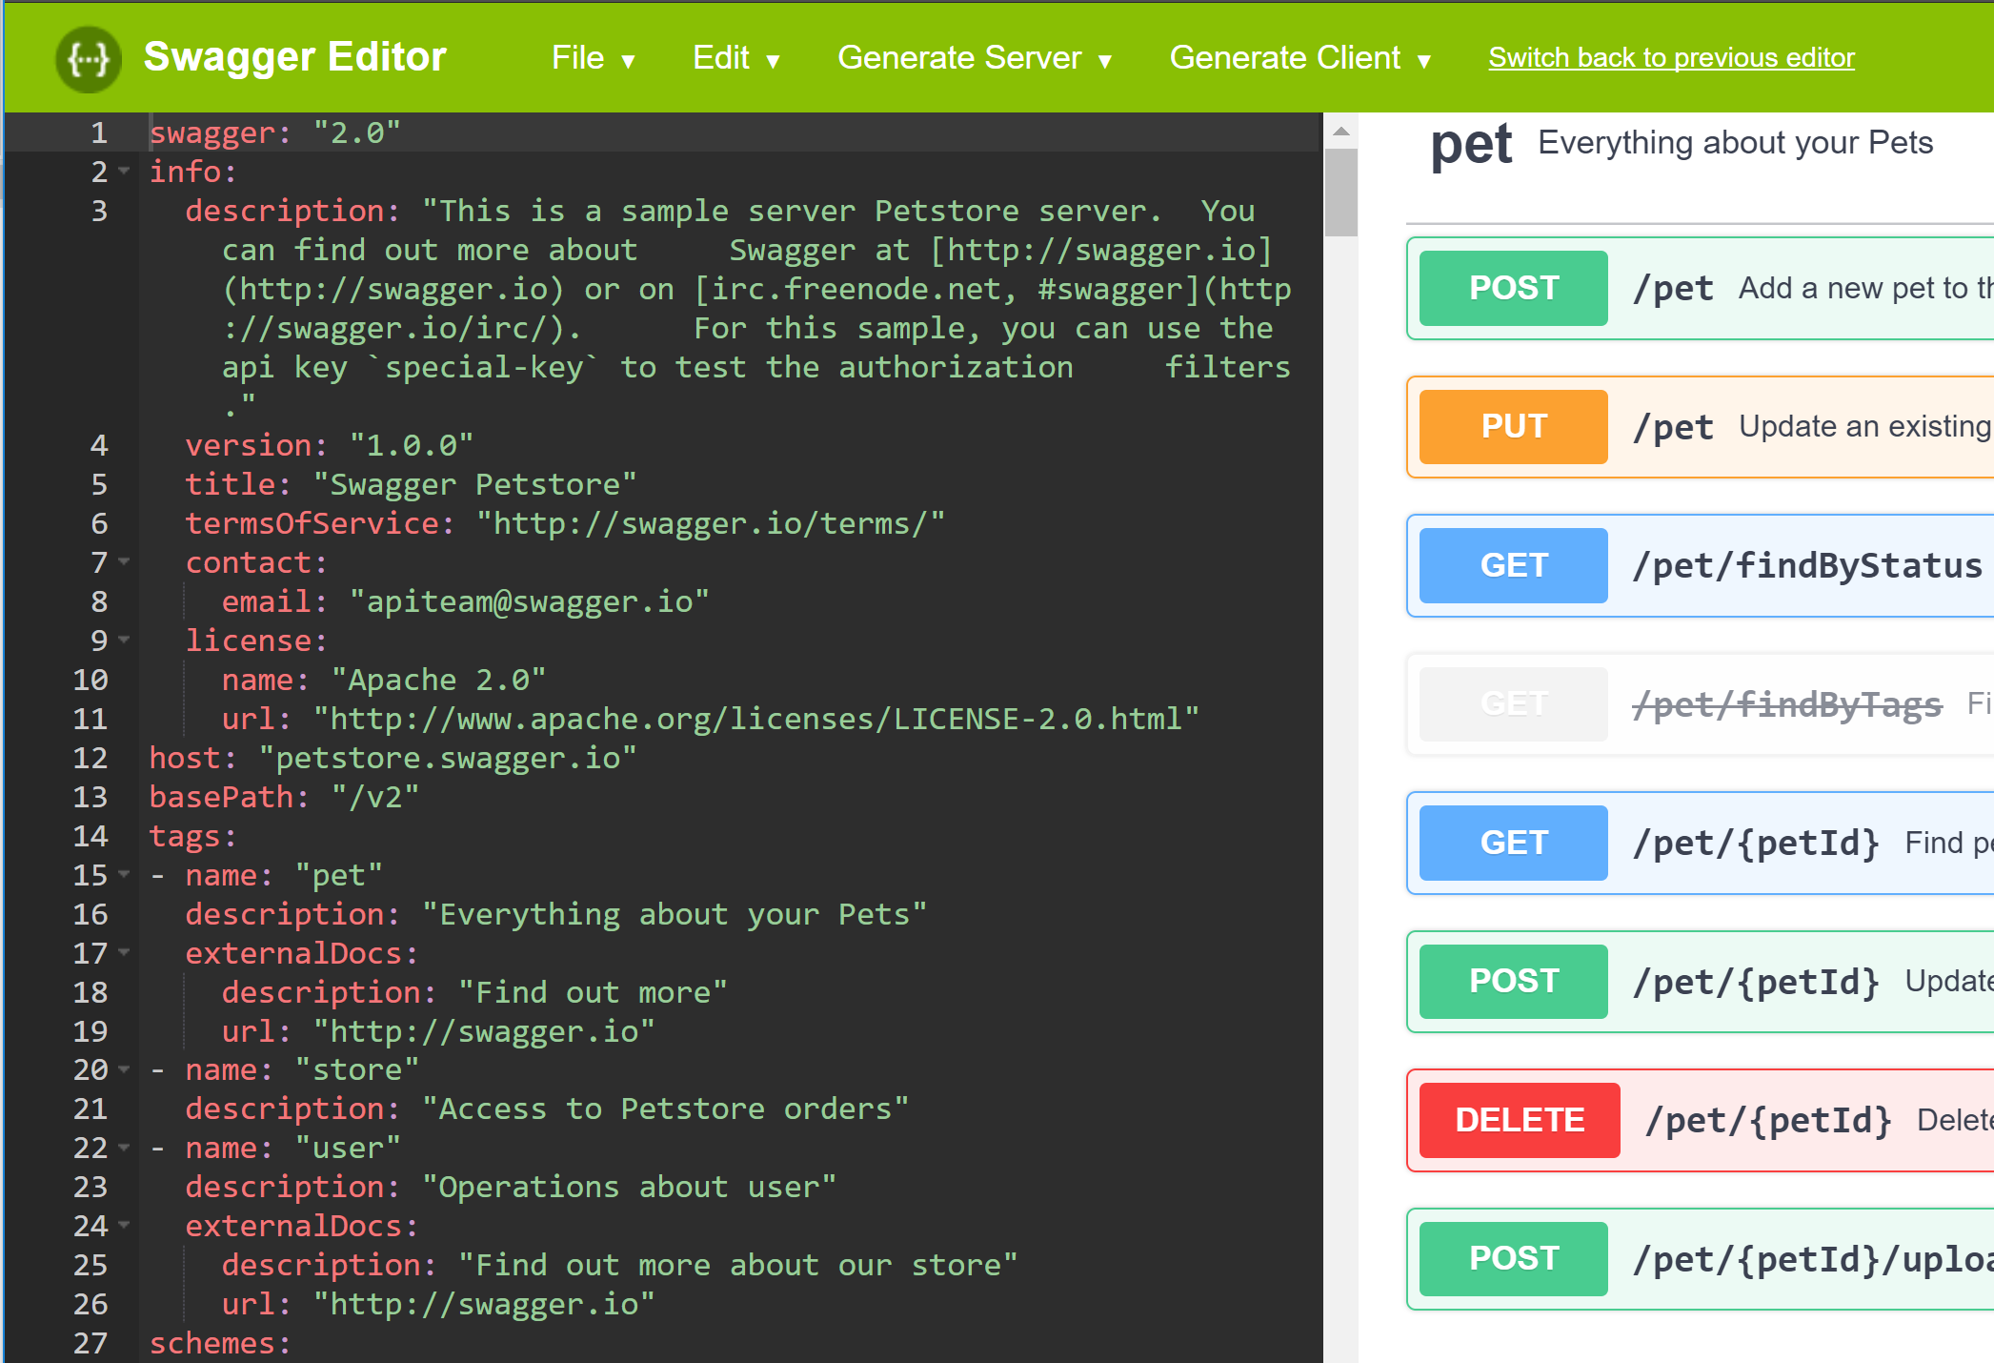
SWAGGER Tools
Swagger Editor
The Swagger Editor is great for quickly getting started with the Swagger specification. It’s clean, efficient, and armed with a number of features to help you design and document your RESTful interfaces, straight out of the box.
Notes:
(5min)
Demo of Swagger.io

Slide 28
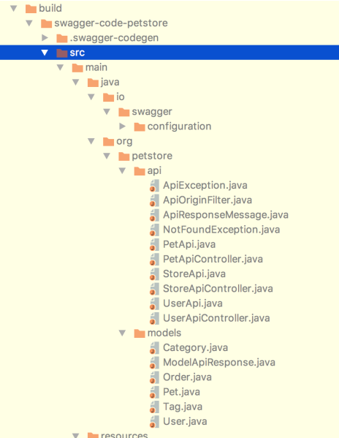
SWAGGER Tools
Swagger Codegen
It can simplify your build process by generating server stubs and client SDKs from your OpenAPI specification, so your team can focus better on your API’s implementation and adoption.
Notes:
5min demo

Slide 29
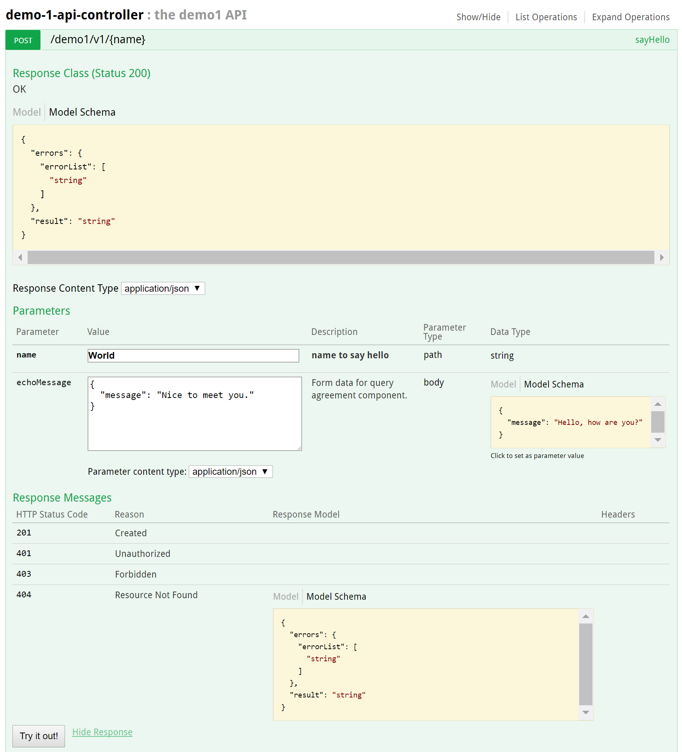
SWAGGER Tools
Swagger UI
It allows anyone to visualize and interact with the API’s resources without having any of the implementation logic in place. It’s automatically generated from your Swagger specification, with the visual documentation making it easy for back end implementation and client side consumption.
Notes:
5min

Slide 30




App Exercise 1
Generate Spring service with Swagger codegen
Notes:
(15min)

Slide 31
App Exercise 1
Generate Spring service with Swagger codegen
1. Download “2a-swagger-codegen.zip” and extract to a folder (e.g. C:\Temp\2a-swagger-codegen)
2. Verify the files in folder “2a-swagger-codegen\swagger”.
config.json – specify the target folders
swagger-demo-service.yml – definition of your service
generate-api.txt – script to generate the code
swagger-codegen-cli-2.3.1.jar – codegen client
3. Generate the service in “swagger" folder by
java -jar swagger-codegen-cli-2.3.1.jar generate -i swagger-demo-service.yml -c config.json -l spring

Slide 32
App Exercise 1
C:.
| .swagger-codegen-ignore
| config.json
| generate-api.txt
| output.doc
| pom.xml
| README.md
| swagger-codegen-cli-2.3.1.jar
| swagger-demo-service.yml|
\---src
\---main
\---java
| \---com
| \---swagger
| \---demo
| | RFC3339DateFormat.java
| | Swagger2SpringBoot.java
| |
| \---api
| | ApiException.java
| | ApiOriginFilter.java
| | ApiResponseMessage.java
| | DemoApi.java
| | DemoApiController.java
| | DemoApiDelegate.java
| | NotFoundException.java
| |
| \---config
| | CustomInstantDeserializer.java
| | HomeController.java
| | JacksonConfiguration.java
| | SwaggerDocumentationConfig.java
| |
| \---model
| GetNameResponse.java
|
\---resources
application.properties
Generate Spring service with Swagger codegen
4. Verify the generated directory structure

Slide 33
Summary
We covered
Rest is a common standard to develop API
We learned how to use Swagger to define Rest API specification
We learned how to generate a microservice stub by using the Swagger specification

Slide 34
References
Architectural Styles and the Design of Network-based Software Architectures
Roy Fielding
REST APIs must be hypertext-driven
Roy Fielding

